Slide 1

MUG(1.0.0) User’s Interface
_a product by crescent

Slide 2

Home Frame
app name
Go to Credit Menu
Go to Help menu
(to tutorial frame)
This bubble shows
Your current mode
(student/ teacher)
EXIT app
Main Navigation Tool
Swipe the screen to spin the wheel to select your desired function
tap the button to go to that function
Tap this button to
toggle between student
and teacher mode

Slide 3
Teacher’s Frames
Teachers have three frames
Add Question Frame
Edit/Delete Question Frame
View Students’ Statistics Frame (currently the same as Student’s Statistics Frame)

Slide 4
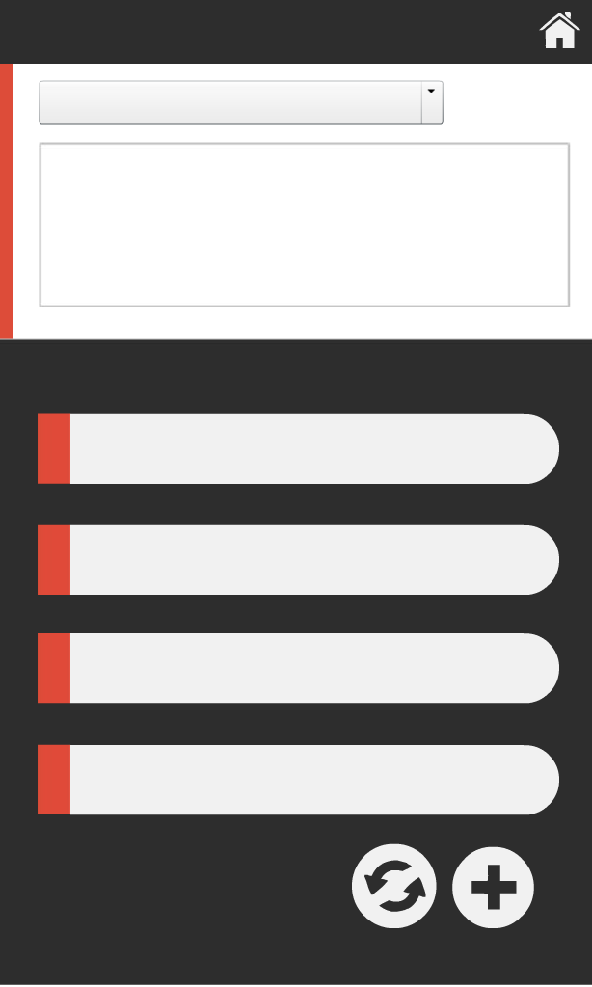
Add Question Frame
Go back to Home Frame
Choose one of
The five default
categories
Input question here
Tap the bar
Of the correct
Answer (only 1)
Input answers here
Accept and add
New question
Clear all fields

Slide 5

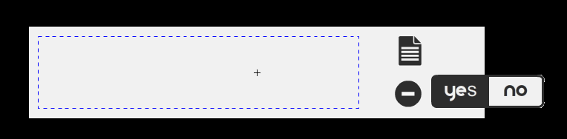
Edit/Delete Question Frame
Go to Home Menu
Start new search
Question Text
Edit Question
Type in
search phrase
Choose
one category
Search results
Will be displayed here
In the above format
Delete question
Bring up yes/no
choice

Slide 6
Students’ Frames
There are three frames in Student Mode:
Answer Question Frame
Changing Preferences Frame
Student Statistics Frame

Slide 7
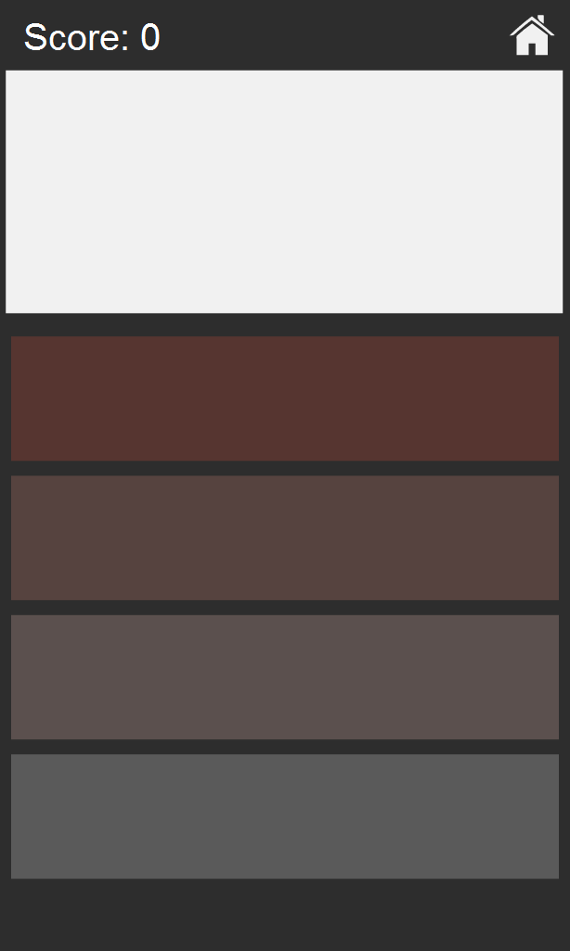
Answer Question Frame
Go back Home
Question Text
Answer Texts
Tap to choose one
Answer
Correct → Green
Wrong → Red
Current Score
By student.
Calculated using
Streaks concept
And time restriction

Slide 8
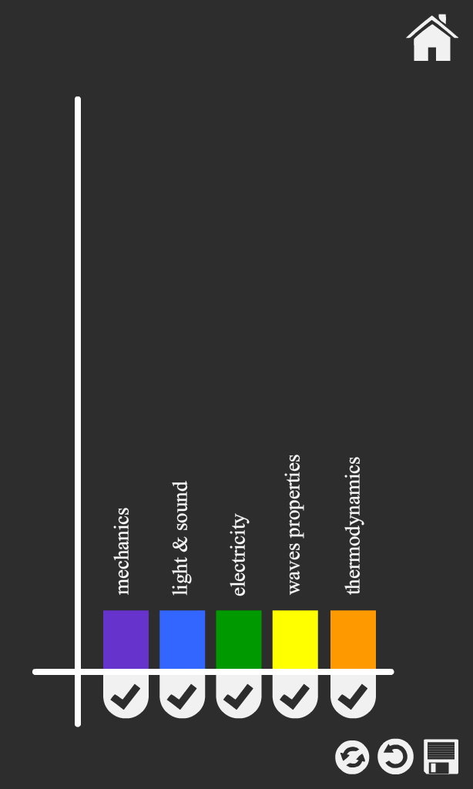
Change Preferences Frame
Go back Home
Each bar corresponds to one category
Drag the bat longer/shorter
To have more/less question in that category
Set to default
Undo
Turn on/off
category
Save changes

Slide 9
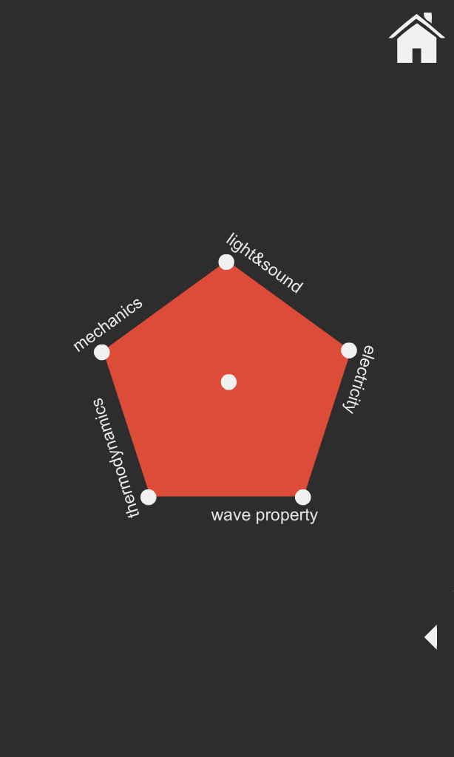
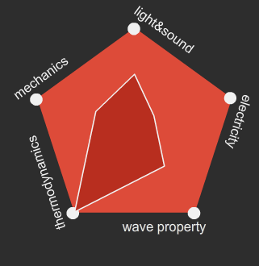
Statistics Frame
Go back Home
Pentagon visualizes student performance in five categories. The larger the inner shape the better
Tap to bring up a brief summary of performance

Slide 10
Miscellaneous Frames
Credit Frames
Help Frame (not yet implemented)

Slide 11
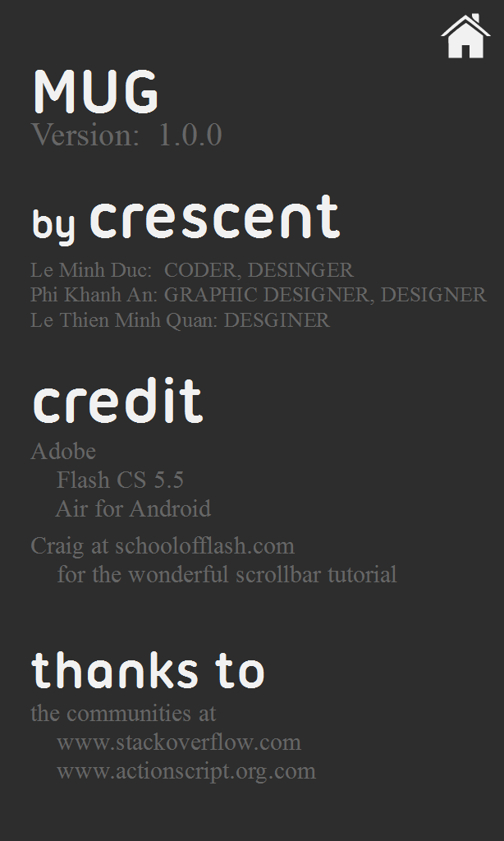
Credit Frame

Slide 12
_a product by crescent
THANK YOU!

